Slide 1
BIOMEDIN 215 Data Science in Medicine
Nigam Shah, MBBS, PhD
nigam@stanford.edu

Slide 2
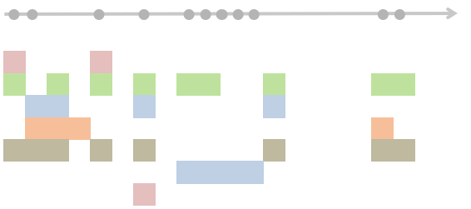
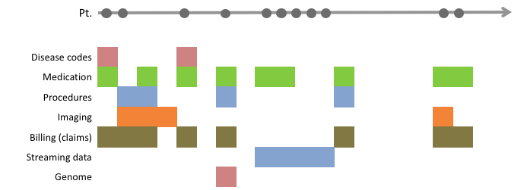
Signposting: Timelines to datasets
1 | 0 | -1
1 | 0 | -1
1 | 0 | -1
1 | 0 | -1
← Persons →
Drugs
Diseases
Devices
Procedures
← Time →
← Features →
The basics:
The anatomy of the healthcare system
The research questions and study designs
The sources of, and errors in, the data used
Using knowledge graph/s of things, and relationships
The choices:
The source and choice of features
How much to agonize over textual data
On the handling of time
In defining an electronic phenotype

Slide 3
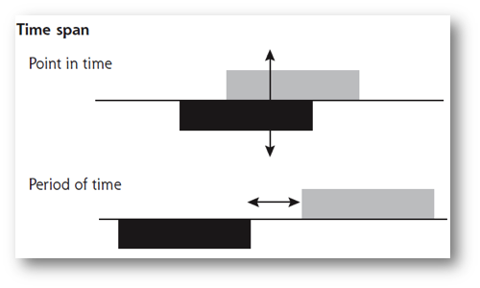
Handling time in your analyses
Data and questions span many timescales, with irregular time intervals
In working with timelines, ordering of events is crucial.
We can use time explicitly (time-series, time-to-outcome) or implicitly (binning)
Timing of exposures and outcomes is crucial. Spend effort getting index time right.
Clinical processes are often nonstationary
Notes:
Stuff to worry about:
Repeated observations
Irregular time intervals
Large number of (sparse) features
Choices of binning
Choices of constructing features

Slide 4
Goals for today
Understand electronic phenotyping
Review the most common approach for electronic phenotyping
Understand the relationship between phenotyping and cohort building
Introduce new (machine learning based) approaches for electronic phenotyping

Slide 5
Phenotyping = Did “it” happen?
Feature engineering
Text processing
Handling of time
Time of “it”
Patient’s Medical Record
ICD9 codes | x |  |  |  | x
CPT codes
Prescription
Procedures |  | x |  |  |  |  |  |  |  |  |  |  | x
Referrals |  |  |  |  |  | x |  |  |  |  |  |  |  |  |  |  |  |  | x
Visit (loc, freq)
Imaging |  | x | x
Physiotherapy |  |  |  |  |  |  | x
Streaming data |  |  |  |  |  |  |  |  | x | x | x | x
Mentions |  |  |  |  |  |  |  |  |  |  |  |  |  |  |  |  | x

Slide 6
Think about the WHAT, WHY, HOW
WHY: for observational research, recruiting into trials, calculating quality metrics, finding ‘similar patients’
WHAT: features, time-frame.
The necessary and sufficient conditions
The start and end criteria
The way you will decide what is ‘good enough’
HOW: [It’s a mess right now]
To state a phenotype
To evaluate a stated phenotype
To guarantee generalizability

Slide 7
Breakout: Let’s craft a phenotype definition
You will find two conditions mentioned on an index card assigned to your team.
Write down the things you would want to see in the record that would make you believe that the outcome or condition in question happened.
With this set of things in hand, write down ways of deciding when you have seen enough to declare that the outcome or condition did happen.

Slide 8
Two approaches to phenotyping
Rule based, expert-consensus definitions
Exemplified by www.phekb.org
Implemented by
STARR tools https://med.stanford.edu/starr-tools
ATLAS https://ohdsi-atlas.stanford.edu/#/home
ACE https://ace-prod.med.stanford.edu/
Probabilistic phenotyping
Relatively new
APHRODITE, ANCHOR learning
https://github.com/OHDSI/Aphrodite

Slide 9
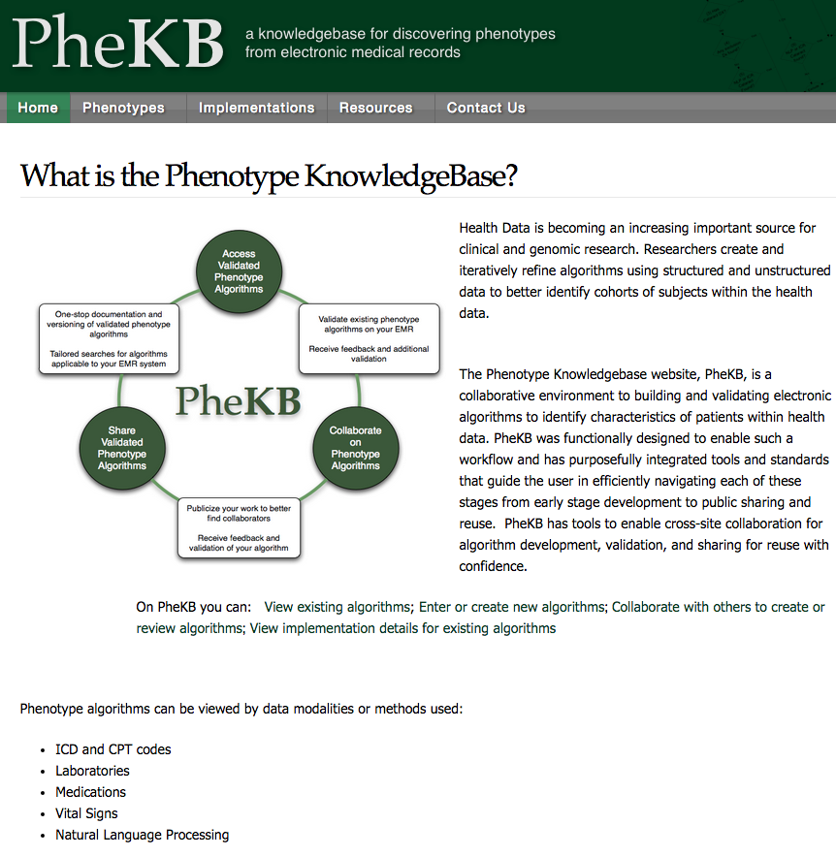
Kirby et al, JAMIA 2016

Slide 10
An example algorithm

Slide 11
Features on which “algorithms” operate

Slide 12
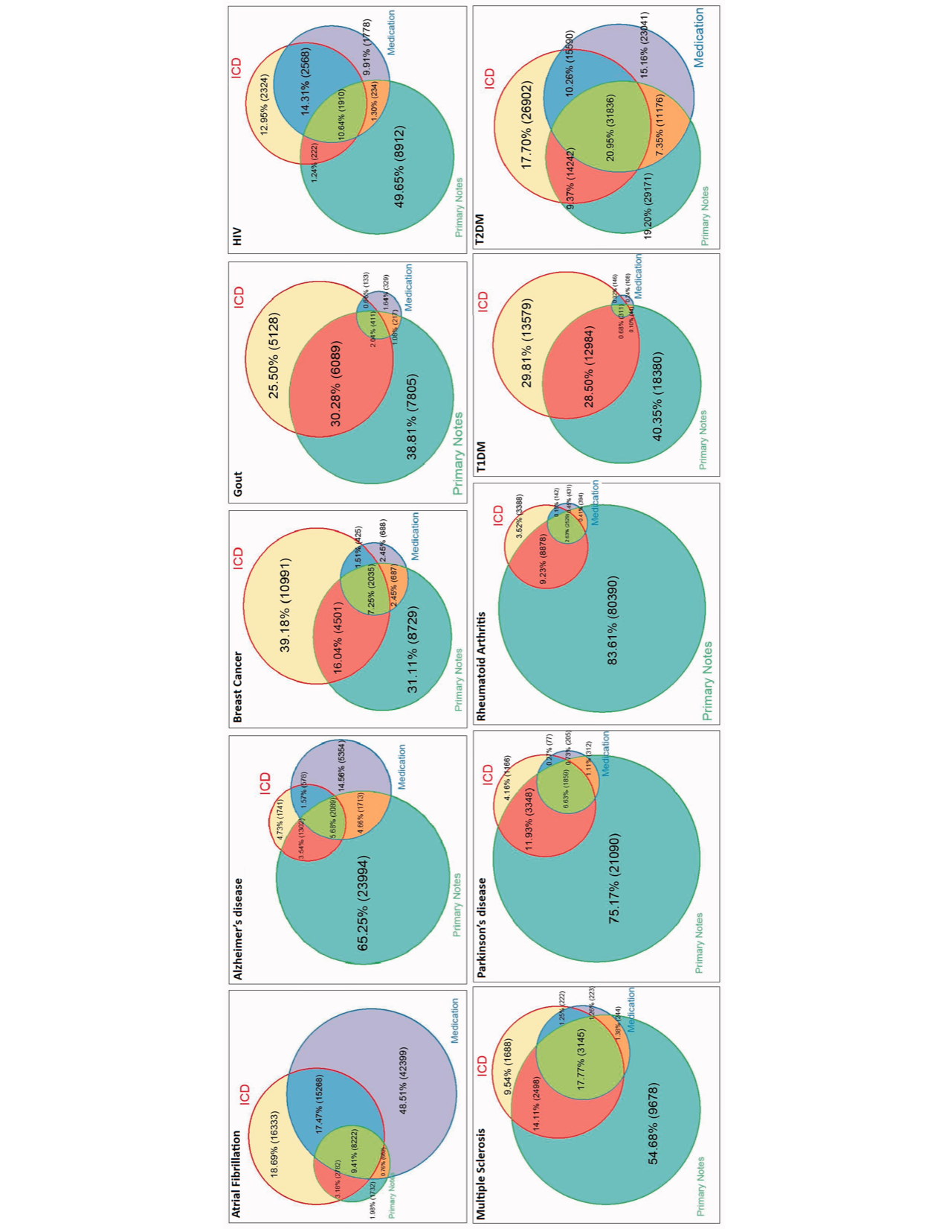
Use multiple sources of data when you can
Wei WQ, et al 2015 JAMIA

Slide 13
Summary of rule-based phenotyping
Figure out what are the “things” you want to see in a record to believe the patient has that condition.
Using the knowledge-graph, which the data conforms to, convert those “things” into specific identifiers
Define the criteria around the presence, absence, frequency of occurrence etc. for those identifiers.

Slide 14
Reflect: on your phenotype definition
Did you get the things you would want to see in the record that would make you believe that the outcome or condition in question happened?
Did you specify the ways of deciding when you have seen enough to declare that the outcome or condition did happen?

Slide 15
Phenotyping and cohort building go hand in hand
Diabetics (defined as icd9 code of 250, and metformin within a week to one month) who have high HbA1c one to two months after treatment, and are prescribed Glipizide

Slide 16
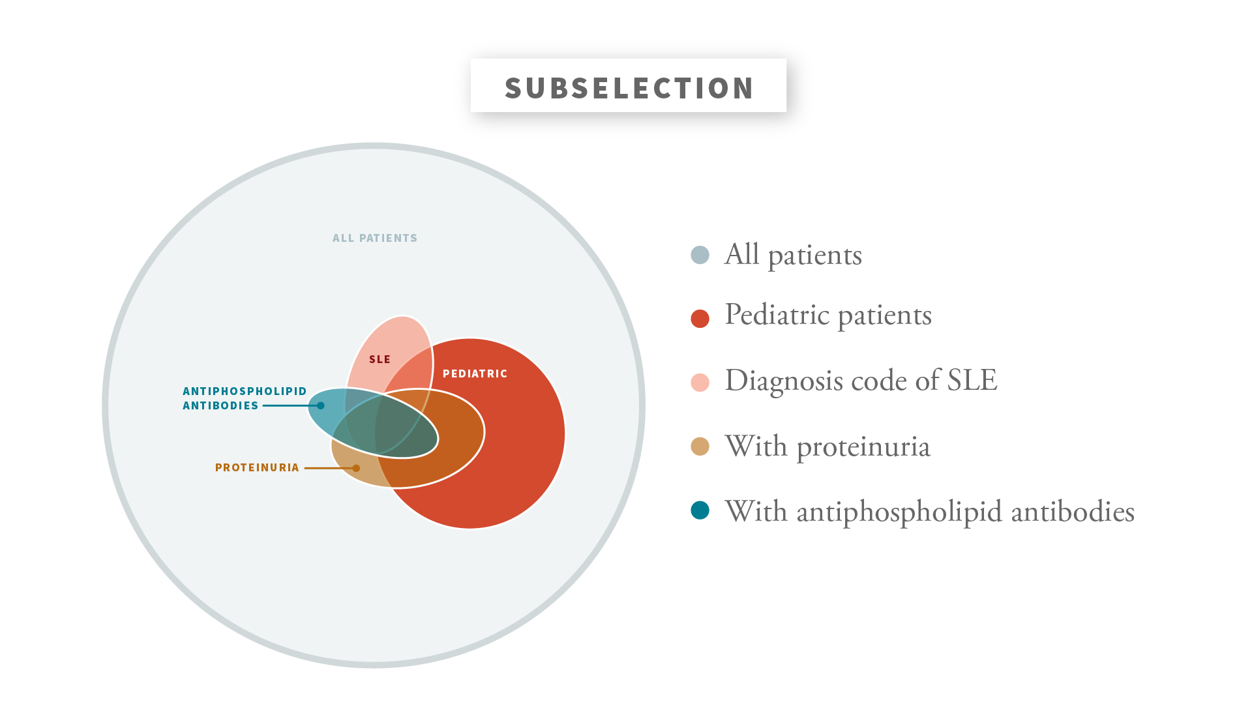
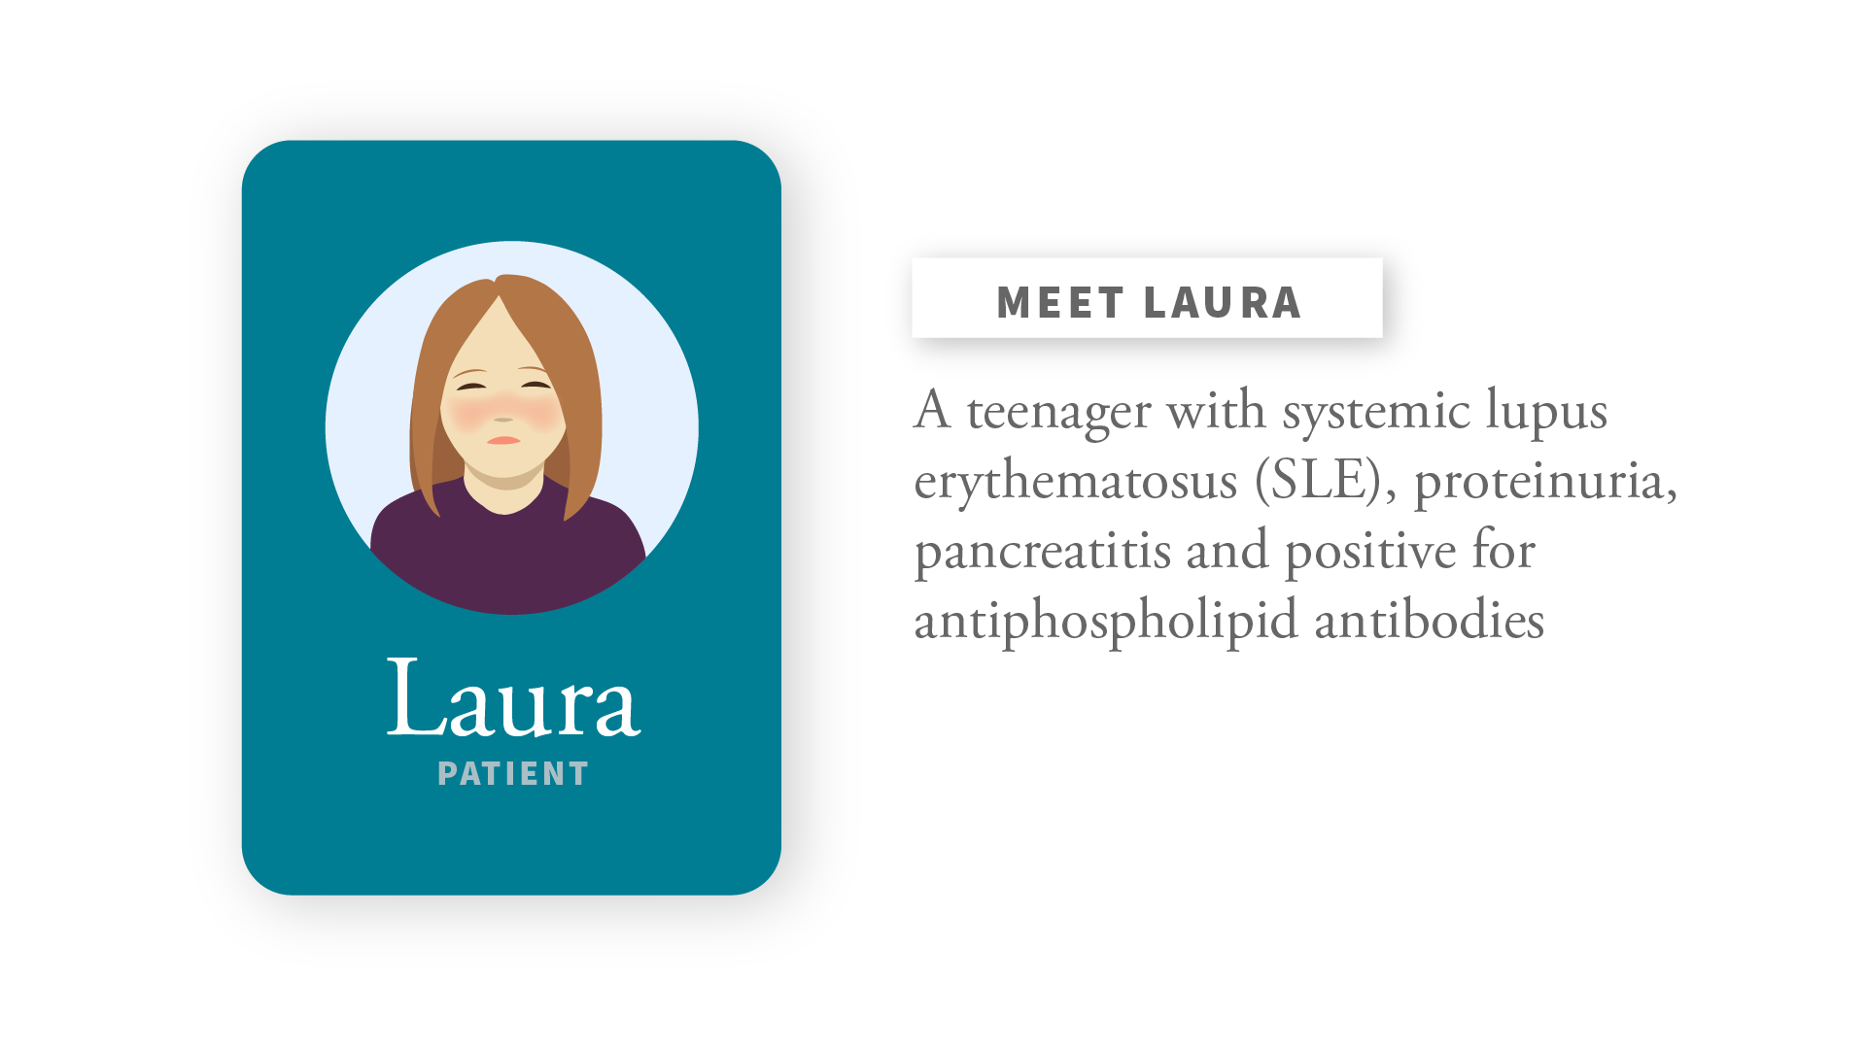
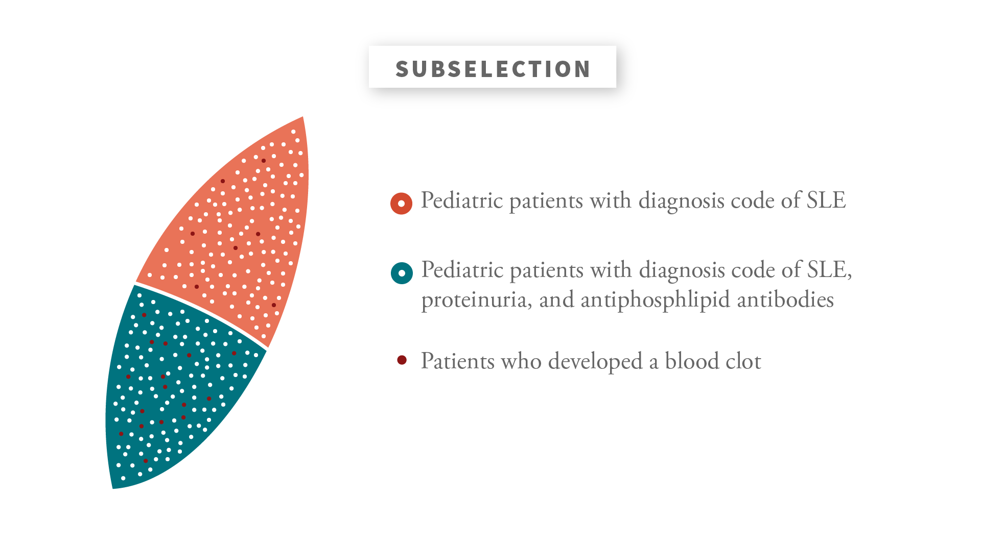
Phenotyping and cohort building go hand in hand

Slide 17
Cohort building and chart review go hand in hand
Once you have a phenotype definition, and a corresponding set of patients, you will need to to “chart review” to assess how good or bad you phenotype definition is.
 | Cohort Building | Review
Epic (SHC) | Slicer, Dicer | Hyperspace
STARR | Cohort discovery tool | Chart Review Tool
STARR/OMOP | ATLAS/Cohort Definition | ATLAS/Profiles
STARR/OMOP | ACE = a cohort engine | ACE / Explore

Slide 18
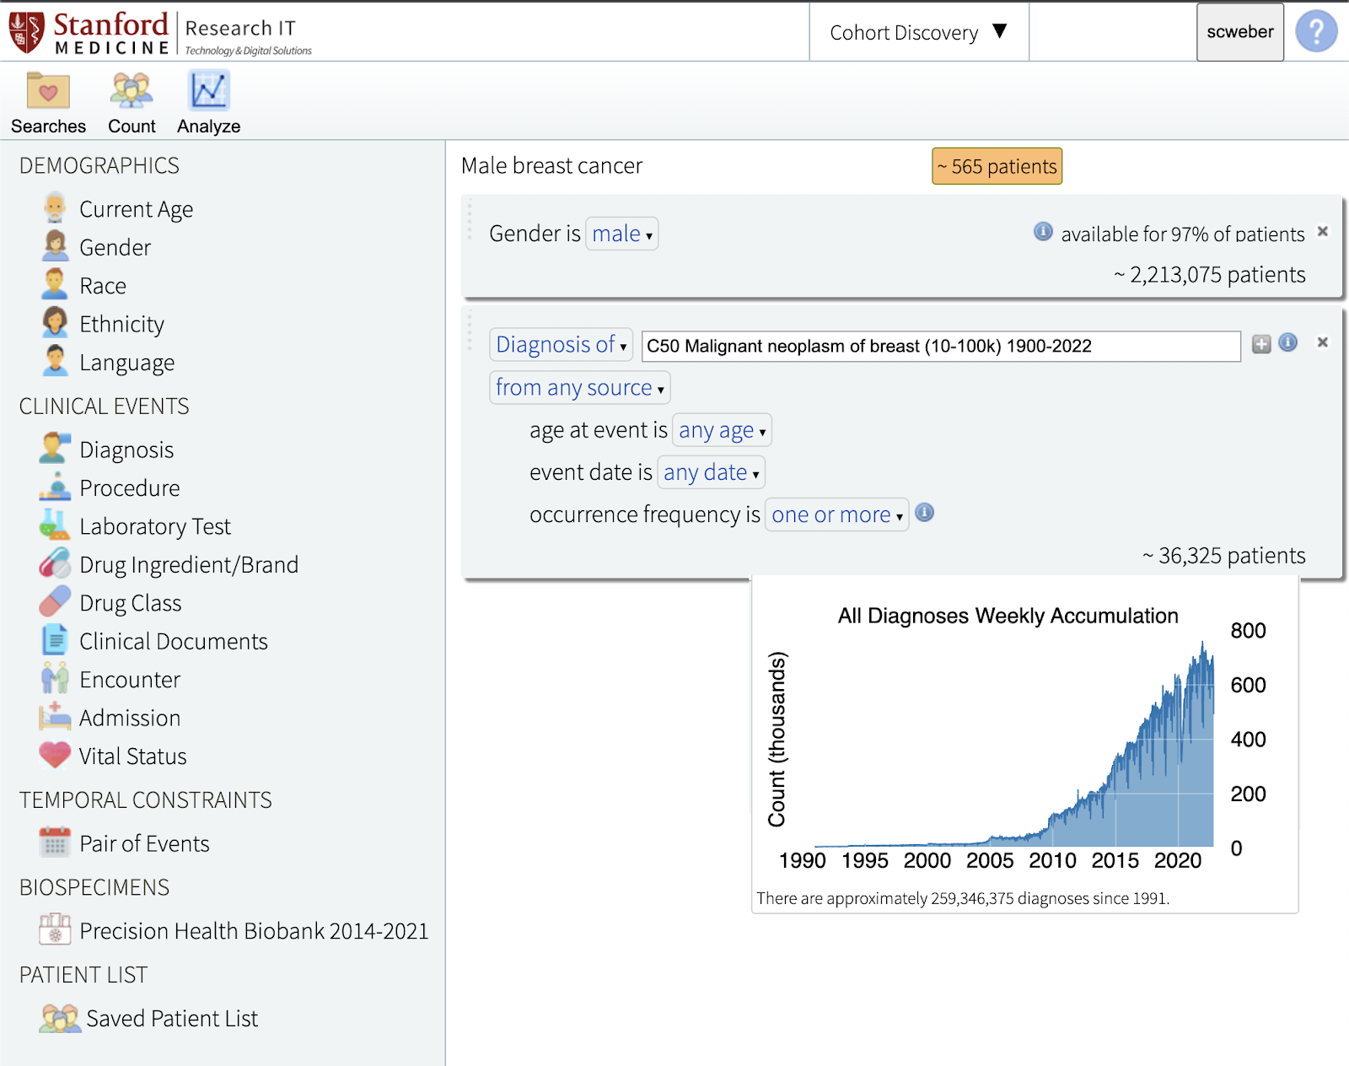
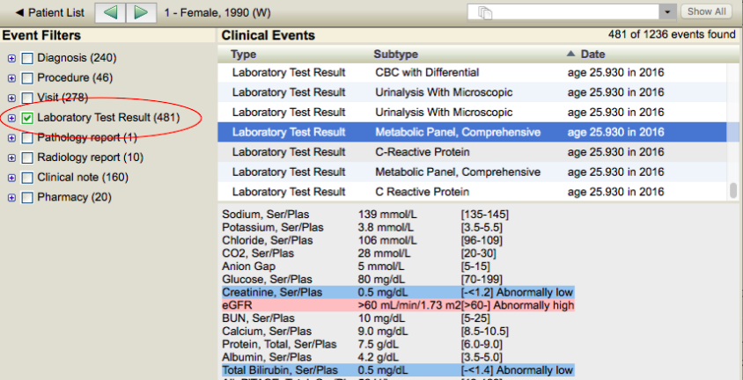
STARR Tools
Notes:
Cohort tool user guide = https://docs.google.com/document/d/1jBPektTrg5H0rFbzi4HERtJ1uJXa_tCShEdl-Uger88/edit#heading=h.oqwsawlvuz4r
Chart review tool user guide = https://docs.google.com/document/d/1E_7YAm98DGsOc4QHFmTTG9zYXNBXXpiK6iXlekt-DFQ/edit#heading=h.xrgpvyi6zso9
STARR Workshops Spring 2023: STARR-Tools - https://www.youtube.com/watch?v=5DVmg6f0kyM

Slide 19
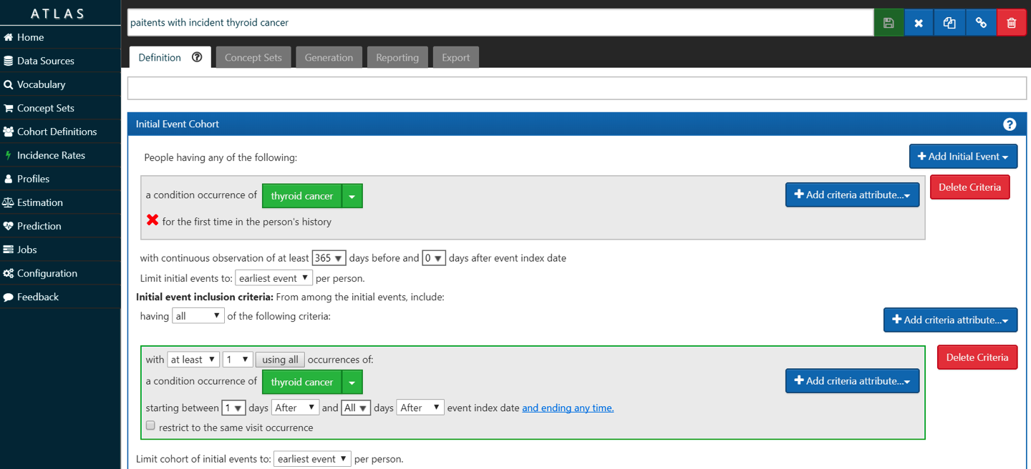
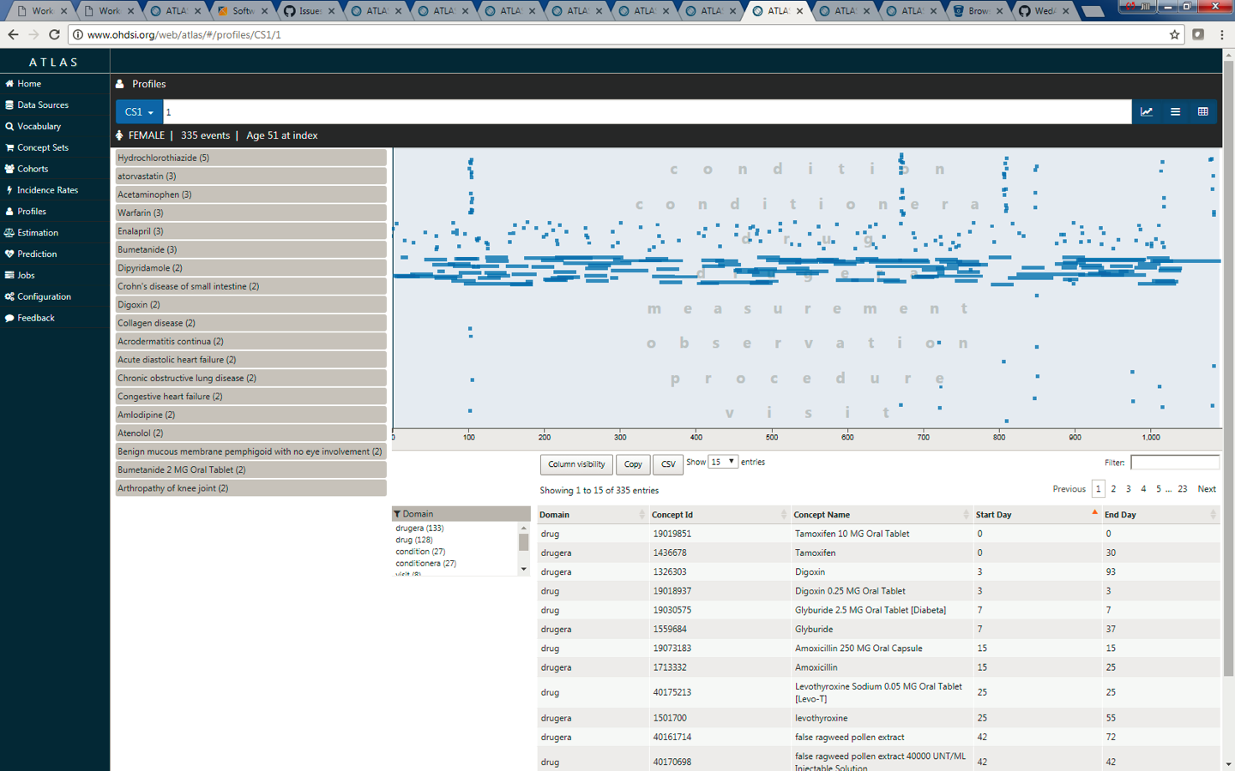
OHDSI ATLAS Cohort Analysis Tool
Notes:
Userid: demo
Password: demo

Slide 20
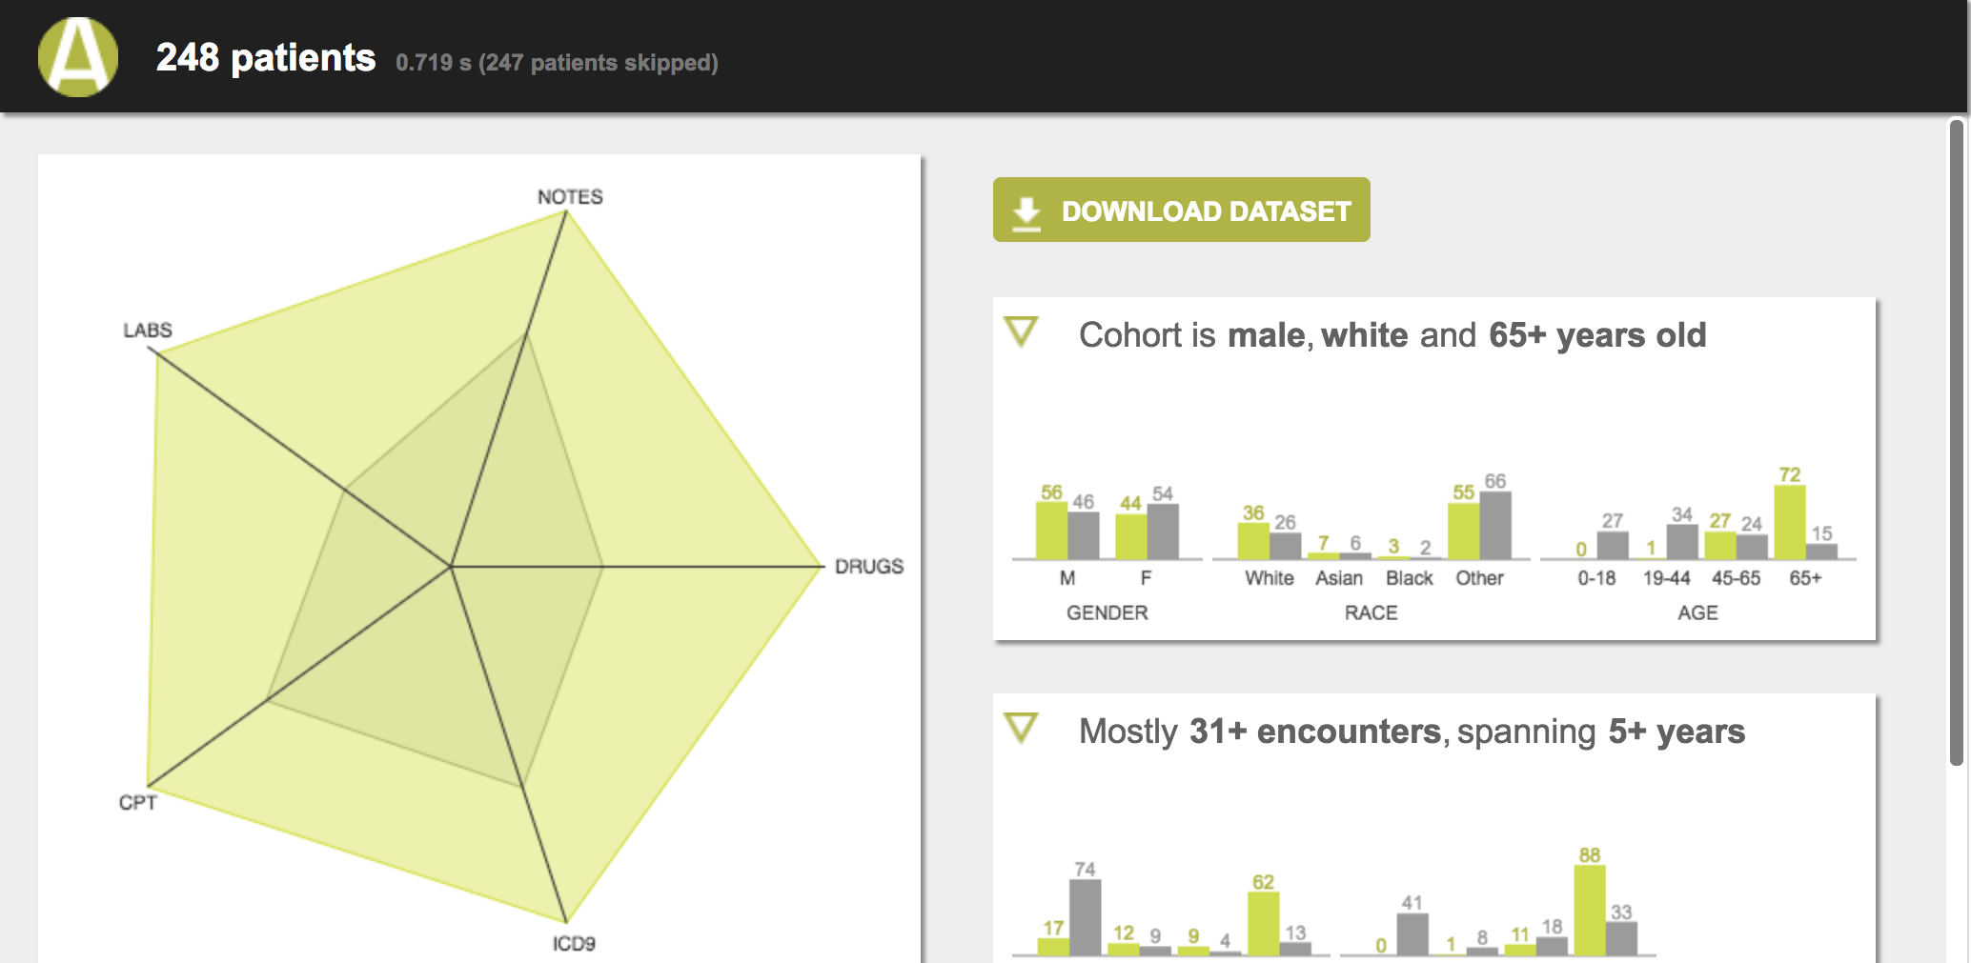
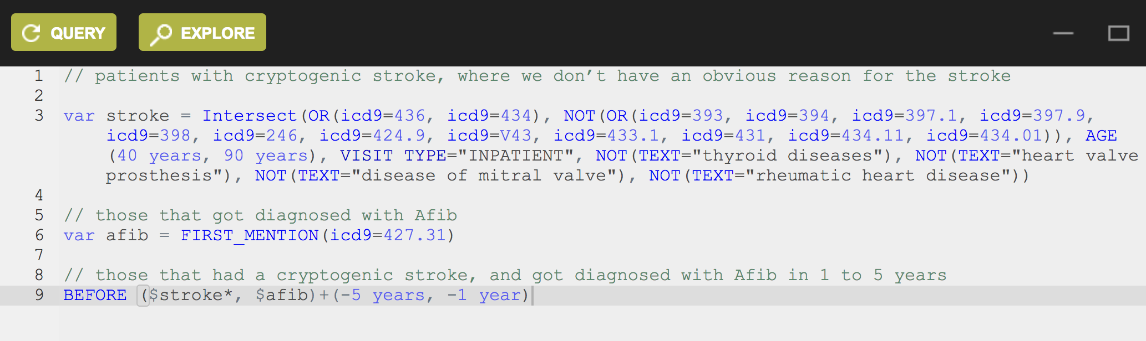
Advanced Cohort Engine (ACE)
Notes:
STARR Workshop Series-Spring 2023:ACE -- https://www.youtube.com/watch?v=n184EeTZhc0

Slide 21
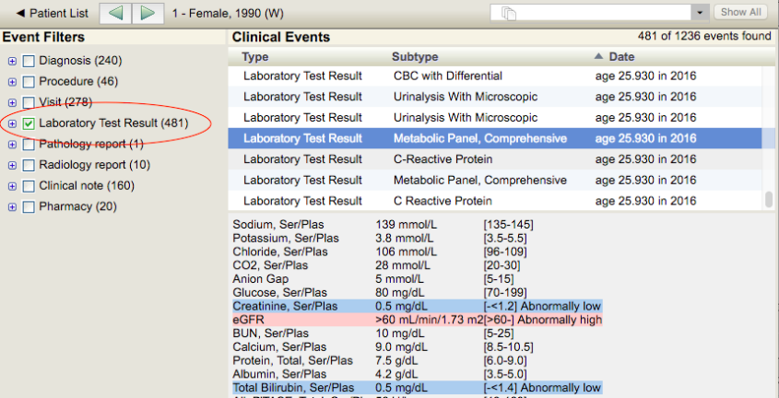
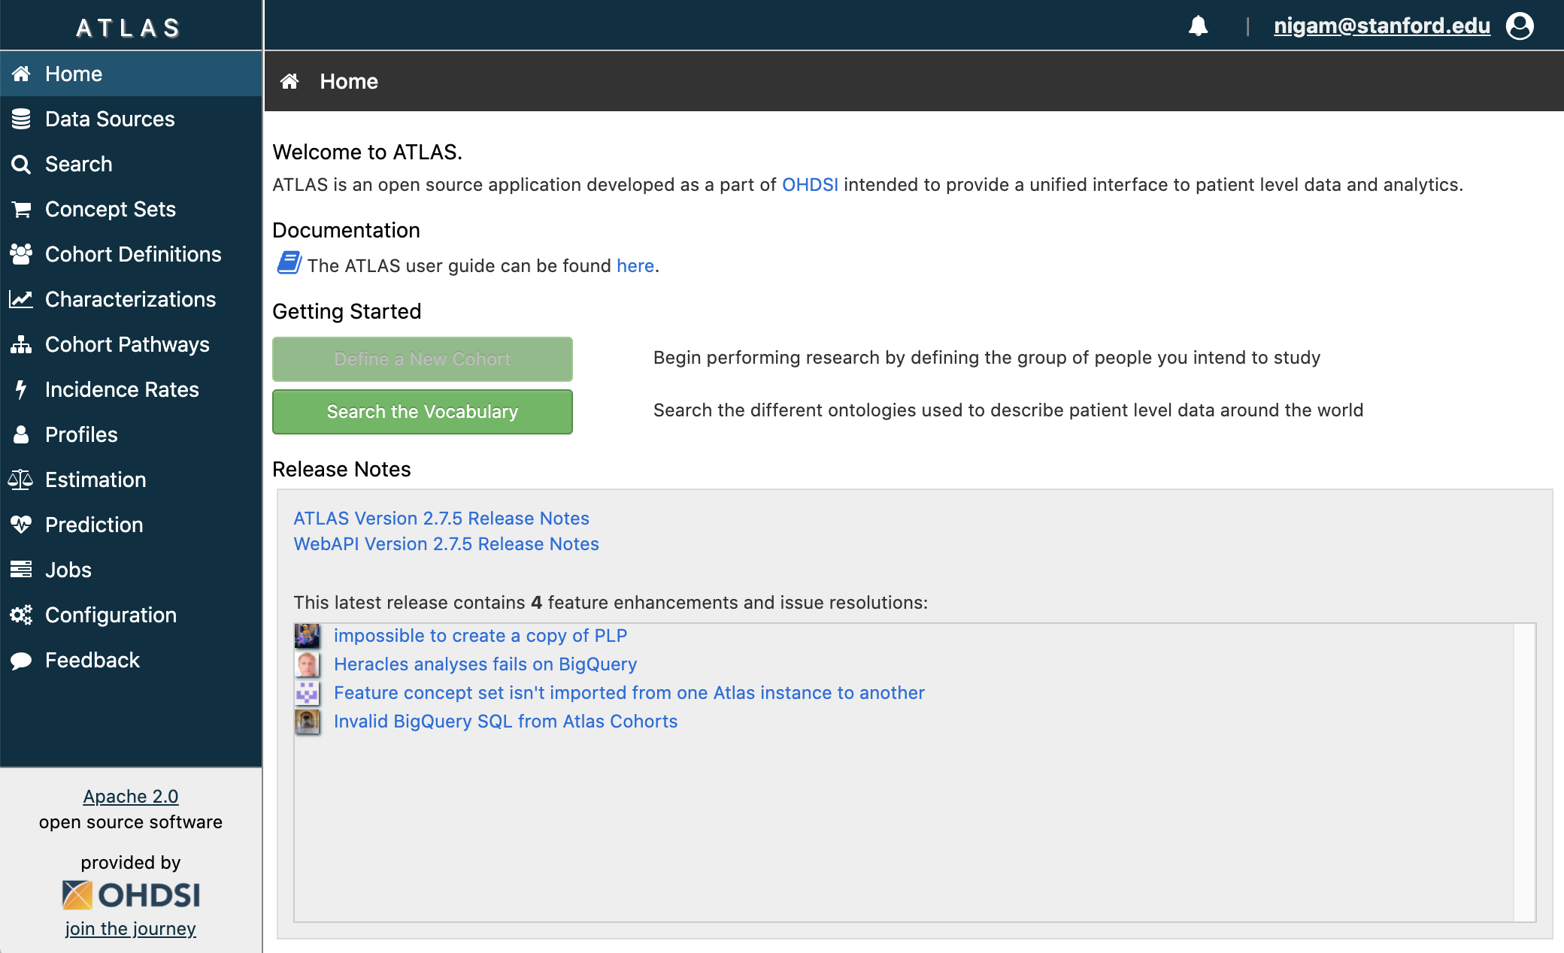
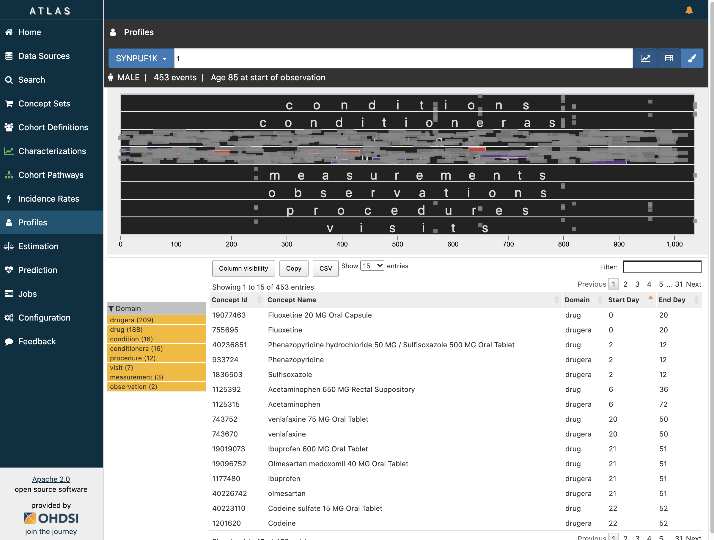

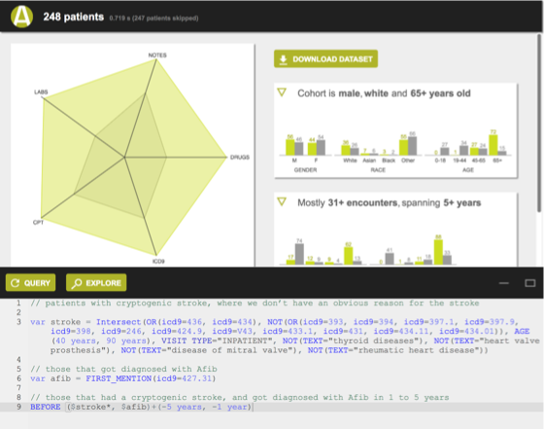
Phenotyping, cohort building, and chart review
Cohort discovery tool
Chart review tool
ATLAS - Cohort
ATLAS - Chart review
STARR-Tools
STARR-OMOP
ACE - Query
ACE - Explore
https://starr.stanford.edu/self-service
Notes:
Find out more at https://www.youtube.com/@stanfordstarr8476/playlists

Slide 22
Take the time to learn these tools
https://starr.stanford.edu/self-service
www.youtube.com/@stanfordstarr8476/playlists

Slide 23
Open questions
Executability and machine readability of phenotype definitions
Transportability of definitions
assurance of the same error rate at other sites.
Throughput in terms of hours per definition
The type 2 diabetes mellitus ‘algorithm’ on slide 10 took about 1900 hours to develop!
Notes:
McBrien et al (PMID 30137498) identified 40 studies reporting on case definitions for 47 unique clinical conditions
The studies used combinations of International Classification of Disease version 9 (ICD-9) codes, Read codes, laboratory values, and medications in their algorithms.
The most common validation metric reported was positive predictive value, with inconsistent reporting of sensitivity and specificity.

Slide 24
Phenotyping at scale
You need to find a way to find patients who have diabetes based on diagnoses codes, lab results, medications, and textual notes. You do not have the time to create the kind of phenotype definitions we just reviewed, and you have heard of ‘machine learning’ ….
Raise hand when ready to share

Slide 25
Phenotyping using machine learning
The core idea is to learn from a set of labeled examples (i.e. supervised learning)
Themes
Convert counts of codes into a probability of having a phenotype
Feature selection using prior knowledge
Create large, imperfectly labeled, training datasets
Notes:
Harvard University
Liao et al, 2010 → 96 RA, and 404 non-RA cases. Trained a logistic regression using features extracted from textual data, and from coded data. PPV of 94% using text + codes vs. 88% using codes only.
Vanderbilt University
Carroll, et al 2011, AMIA Symp. Proc
Stanford University
Agarwal et al 2016, JAMIA
New York University
Halpern et al 2016, JAMIA

Slide 26
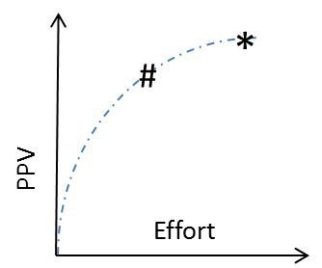
Effort precision trade off
Acc | PPV | Time
0.98 | 0.96 | 1900
Acc | PPV | Time
0.90 | 0.91 | 2hr

Slide 27
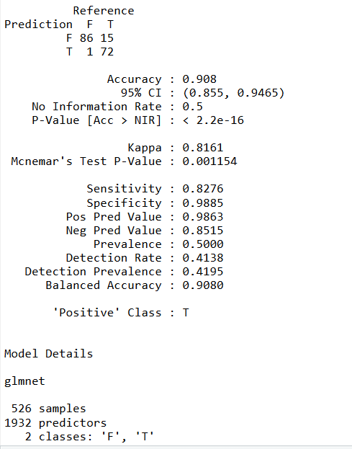
http://github.com/OHDSI/Aphrodite
Build phenotype models in 5 easy steps!
Designed and Implemented using OHDSI CDMv5 and Vocabulary 5
Implements XPRESS, and anchor learning (by David Sontag’s team)
Notes:
Automated PHenotype Routine for Observational Definition, Identification, Training and Evaluation (APHRODITE)

Slide 28
Remember:
Most approaches think of a phenotype as a set of rules (often called an algorithm!).
Think of a phenotype as a collection of features in the data.
For example, ‘diabetes’, would be associated with a high prevalence of anti-diabetic drugs, foot-examination procedures, glucose measurements.
Think about methods to identify these features, their importance, and utility across multiple sources
Terms in text, ICD codes, Labs, Meds, <what else>
Notes:
Discuss active learning

Slide 29
Related: Digital Phenotypes
Also called “digital biomarkers”
e.g. typing patterns for cognitive decline
Early days for these “digital phenotypes”.
need to be reproducible across cultures, countries, time, and places.
not at the same level of reliability as ‘fever’ or ‘high blood pressure’.

Slide 30
Assigned reading
Banda JM, Seneviratne M, Hernandez-Boussard T, Shah NH.
Advances in Electronic Phenotyping: From Rule-Based Definitions to Machine Learning Models.
Annu Rev Biomed Data Sci. 2018;1:53-68. doi:10.1146/annurev-biodatasci-080917-013315

Slide 31
Self study material

Slide 32
Efforts to know if you do probabilistic phenotyping
APHRODITE = an R package that combines the ideas of learning using noisy labels (Agarwal et al) and Anchor-based learning (Halpern et al).
Yu et al, AFEP = to develop phenotyping algorithms in an unbiased manner by automatically extracting and selecting informative features, which can be comparable to expert-curated ones in classification accuracy.
Zheng et al, PheMap = PheMap is a knowledge base of medical concepts with quantified relationships to phenotypes that have been extracted by natural language processing from publicly available resources. PheMap searches EHRs for each phenotype’s quantified concepts and uses them to calculate an individual’s probability of having this phenotype.
Sinnott et al, PheProb = an approach which converts diagnosis codes into a probability of a phenotype. Subjects are assigned a probability of having the phenotype based on the number of diagnosis codes.
Notes:
Noisy labels, Agarwal et al = https://pubmed.ncbi.nlm.nih.gov/27174893/
Anchors, Halpern et al = https://pubmed.ncbi.nlm.nih.gov/27107443/
Automated Feature Extraction for Phenotyping (AFEP), Yu et al - https://pubmed.ncbi.nlm.nih.gov/25929596/
Sinnott et al - https://pubmed.ncbi.nlm.nih.gov/29788308/
Zheng et al - https://pubmed.ncbi.nlm.nih.gov/32974638/

Slide 33
Remember: feature engineering
LABS
LAB:HBA1c (High)
LAB:Blood Glucose: High
LAB:Blood Glucose: High
LAB:Blood Glucose: Normal
CODES
PRESCRIPTIONS
Term to Concept
CONCEPTS
ICD9: 250.00
ICD9: 790.2
MED: 6809
MED: 4815
Diabetes mellitus
Diabetes mellitus
Metformin
Metformin.
TERMS
Diabetes
Diabetes nos
Metformin
Dimethylbiguanidine
 |  |  |  | ✖ | ✗ | ✕ | + | ✜ | ✜ | ✓ | ✓
MR#
CONCEPT FEATURES:
CODE FEATURES:
PRESCRIPTION FEATURES:
LAB
FEATURES:
Structured and unstructured data from a record is represented as a vector of features
f_{c} =
f_{co} =
f_{p} =
f_{l} =
#Notes in which the concept occurs at least once
Counts of a code
Counts of a RxCUI
Counts of a lab-result
Total number of codes
Total number of RxCUIs
Total number of lab-results
Notes:
Features
Time zero: First mention of an identifying keyword
Collapse terms to concept (UMLS)
Use term disambiguation
Note frequency
Rx: Counts of presence/absence of active ingredient
Labs: Counts of test + categorical result (high, normal, low)
Codes: ICD-9 counts

